Slide 1

Class: Machine Learning for networks Professor: Andrea ARALLDO
Intrusion Detection KDD CUP 99 Data Set
Name: Wilmar QUIROGA
Project: Intrusion detection
[1]
1

Slide 2

Introduction
The importance of cyber security is given because according to the European Commission:
In 2020, the amount of data stolen on a monthly basis in the EU exceeded 10 terabytes.
In the EU, ransomware stands out as a major cyber threat.
Distributed Denial of Service (DDoS) attacks also rank among the highest threats.
The estimated annual cost of cybercrime to the global economy was €5.5 trillion at the end of 2020
[3]
[2]
2

Slide 3


Top Cyber Threats in Europe
3
[3]

Slide 4


[3]
4

Slide 5
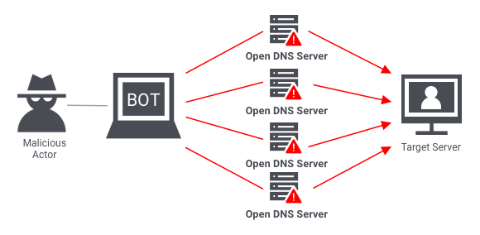
KDD CUP 99 Data Set
The DARPA’98 IDS evaluation program collected around 4 gigabytes of compressed raw (binary) tcpdump and System events data over 7 weeks of network traffic, so The KDD training dataset has roughly 4.9 million single connection vectors with 41 features, labeled as either normal or an attack
The simulated attacks belong to one of four categories.
Denial of Service Attack (DoS):
User to Root Attack (U2R):
Remote to Local Attack (R2L):
Probing Attack:
[4]
[5]
5

Slide 6
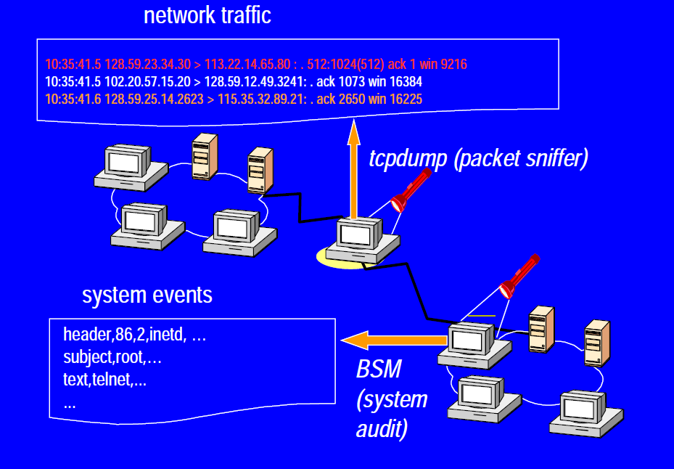
[6]
6

Slide 7
Features in the Dataset
Basic features: This group includes all the characteristics that can be obtained from a TCP/IP connection, many of which result in a delay in detection.
Traffic features: This category is composed of features that are calculated within a window interval and is divided into two groups.
“same host” features: This group of features analyzes only connections from the past 2 seconds that have the same destination host as the current connection.
“same service” features: This category involves analyzing only the connections that have the same service as the current connection within the past 2 seconds.
7

Slide 8
Traffic Features Type
srv_count | Int64
serror_rate | Float64
srv_serrot_rate | Float64
rerror_rate | Float64
srv_serror_rate | Float64
same_srv_rate | Float64
diff_srv_rate | Float64
srv_diff_host_rate | Float64
dst_host_count | int64
dst_host_srv_count | int64
dst_host_same_srv_rate | int64
dst_host_diff_srv_rate | int64
dst_host_same_src_port_rate | int64
dst_host_srv_diff_host_rate | int64
dst_host_serror_rate | int64
dst_host_srv_serror_rate | int64
dst_host_rerror_rate | int64
dst_host_srv_rerror_rate | int64
Features:
Content Features Type
num_failed_logins | Int64
logged_in | int64
num_compromised | int64
root_shell | int64
su_attempted | int64
num_root | Int64
num_file_creations | Int64
num_shells | int64
num_access_files | int64
num_outbound_cms | int64
is_host_login | int64
is_guest_login | int64
count | int64
Basic Features Type
Duration | Int64
Protocol type | Object(Categorical)
Service | Object(Categorical)
Flag | Object(Categorical)
Source bytes | int64
Destination Bytes | Int64
Land | Int64
Wrong Fragment | int64
Urgent | int64
Hot | int64
8

Slide 9
Categorize the types of attacks
Denial of Service Attack (DoS)
User to Root Attack (U2R)
Back
Land
Neptune
Pod
Smurf
Teardrop
Buffer overflow
Loadmodule
perl
rootkit
Probing Attack:
Remote to Local Attack (R2L)
Ip sweep
Nmap
Port sweep
Satan
ftp write
Guess password
imap
Multihop
Phf
Spy
Warez client
Warez master
9

Slide 10
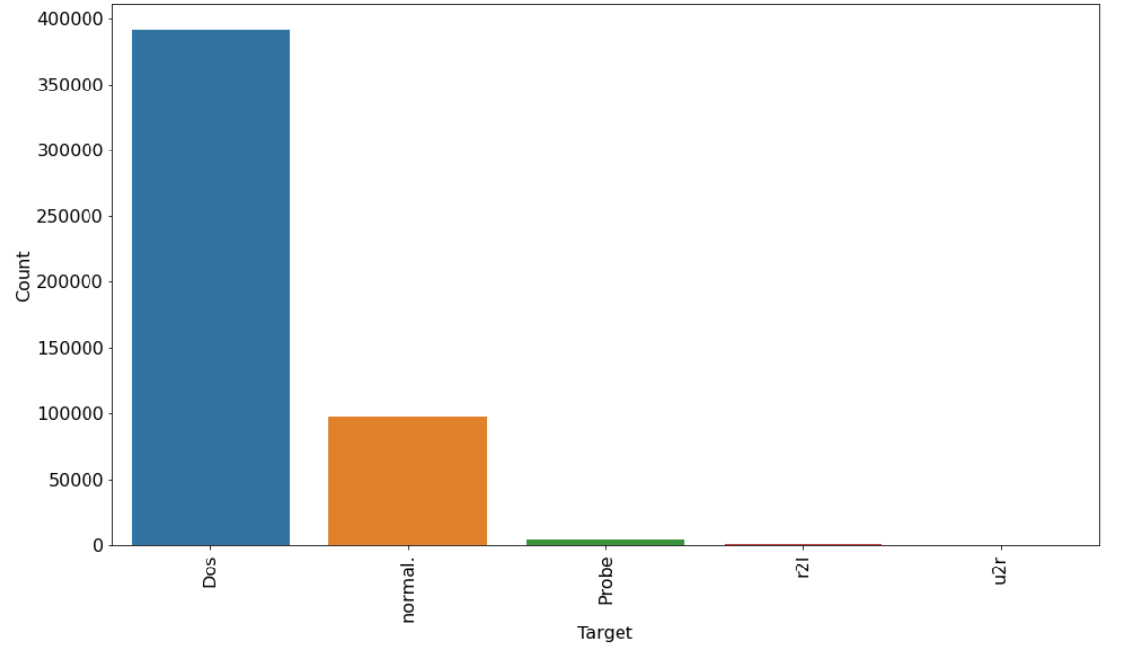
Distribution of number of attacks by category
10

Slide 11
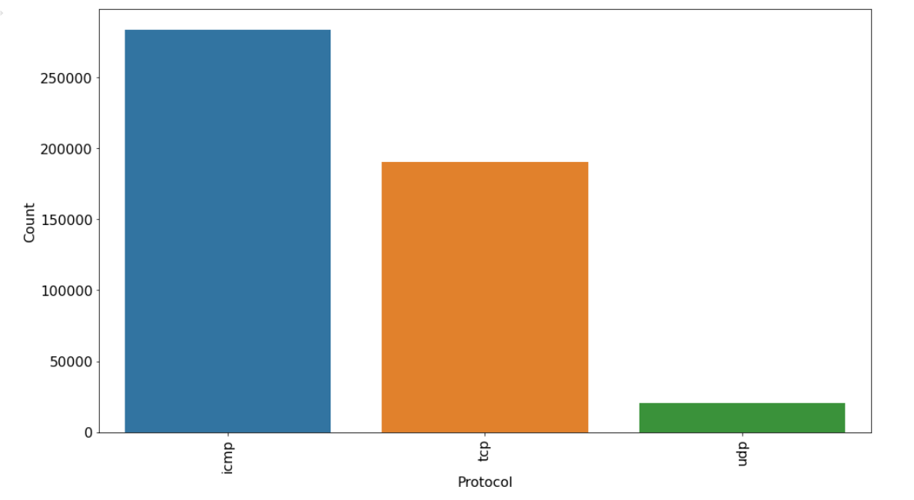
Protocol distribution
11

Slide 12
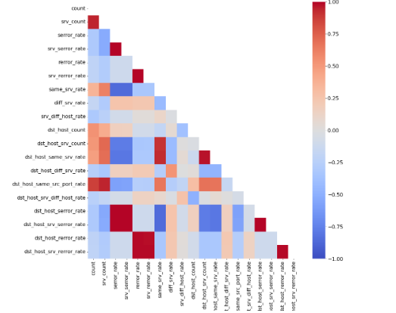
Finding correlated variables
12

Slide 13
Most correlated variables
Variable 1 | Variable 2 | Correlation
serror-rate | dst_host_srv_serror_rate | 0.997
serror-rate | dst_host_serror_rate | 0.998
srv_count | dst_host_same_src_port_rate | 0.994
count | dst_host_same_src_port_rate | 0.86
rerror_rate | dst_host_srv_serror_rate | 0.985
rerror_rate | dst_host_rerror_rate | 0.986
srv_rerror_rate | dst_host_srv_rerror_rate | 0.986
srv_rerror_rate | dst_host_rerror_rate | 0.986
same_srv_rate | dst_host_same_srv_rate | 0.927
same_srv_rate | dst_host_srv_count | 0.898
hot | is_guest_login | 0.843
num_root | num_compromised | 0.993
num_compromised | su_attempted | 0.701
Eliminate the most correlated characteristics and those that have a unique value such as num_outbound_cmds and is_host_login
13

Slide 14
Models Performance
Model | MME Train | MME Test | Train Accuracy | Test Accuracy
Decision Tree Classifier | 0.003 | 0.034 | 0.999 | 0.999
Logistic Regression | 0.111 | 0.119 | 0.992 | 0.991
Neural Networks | 0.179 | 0.178 | 0.975 | 0.975
Support vector machine | 0.114 | 0.118 | 0.993 | 0.992
14

Slide 15
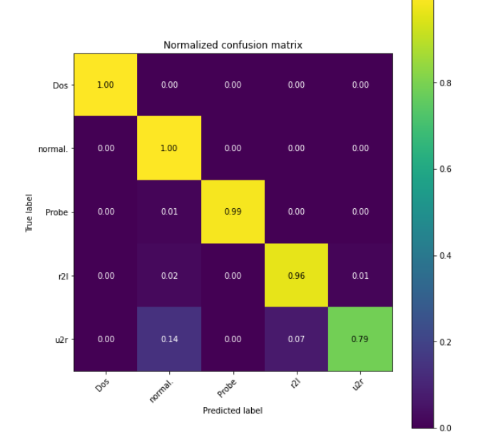
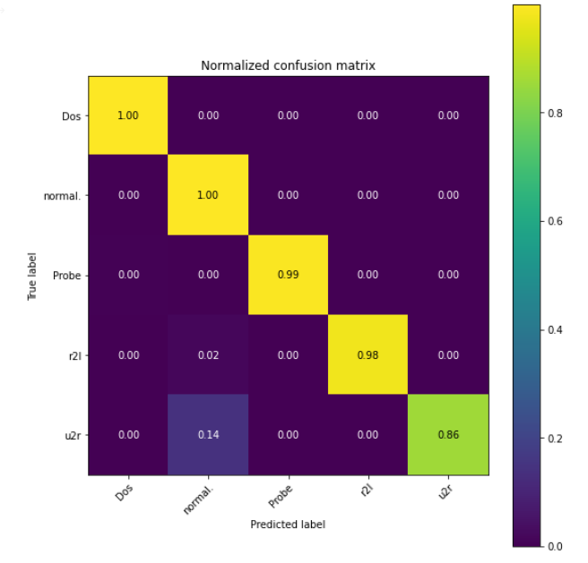
Confusion Matrix Decision Tree Classifier
MinMax Scaler
Standard Scaler
15

Slide 16
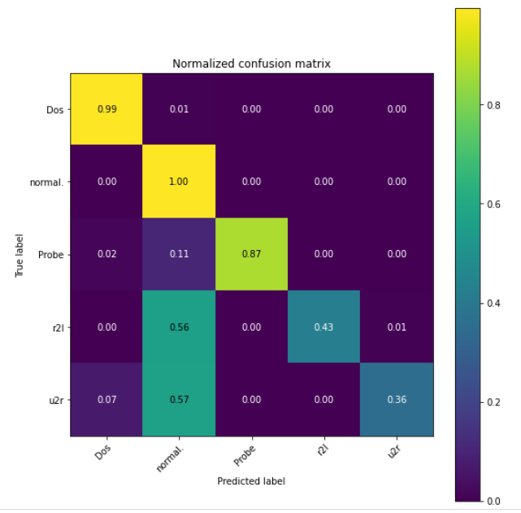
Confusion Matrix Logistic Regression
16

Slide 17
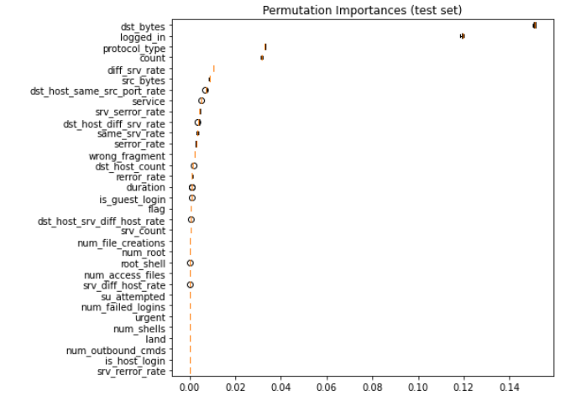
Feature importance Decision Tree Classifier
17

Slide 18
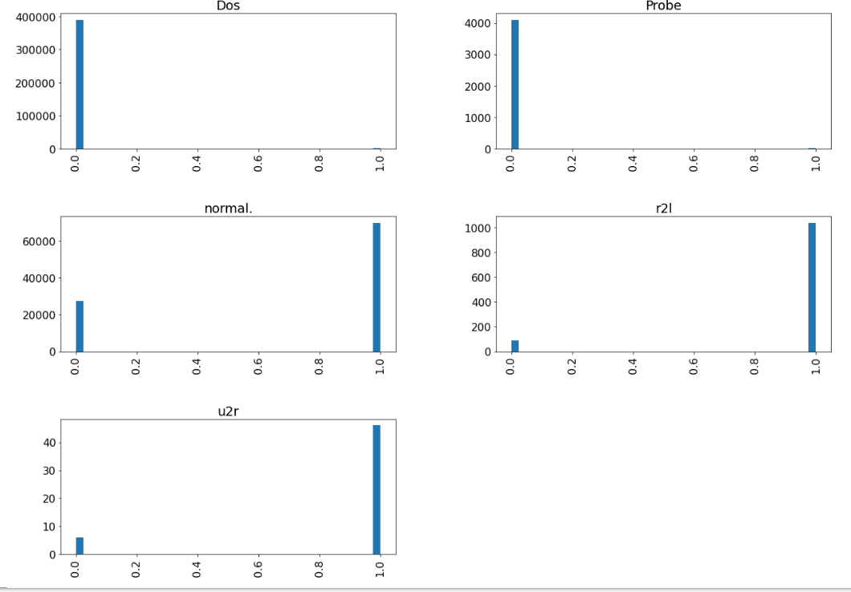
Histogram of loggin_in feature Group by Target
18

Slide 19
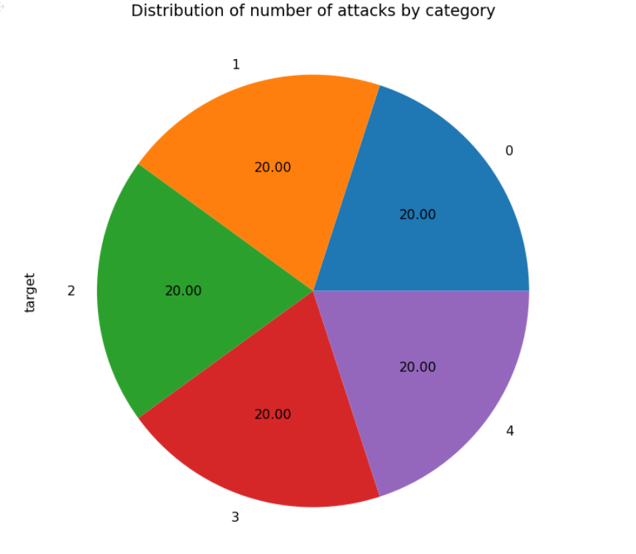
Balanced Dataset
Dos: 0
Normal: 1
Probe: 2
r2l: 3
u2r: 4
19

Slide 20
Decision Tree Classifier
Model | MME Train | MME Test | Train Accuracy | Test Accuracy
Decision Tree Classifier | 0.0 | 0.411 | 1.0 | 0.923
20

Slide 21
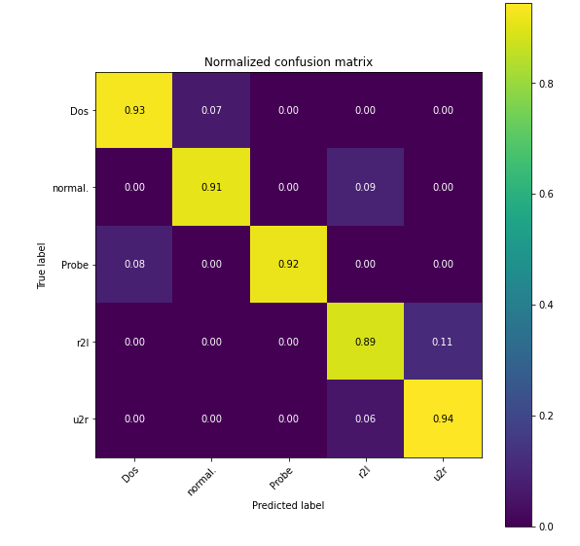
Confusion Matrix Balanced Dataset
21

Slide 22
Conclusions
The dataset is unbalanced, that is, although we have a very good accuracy, the less frequent classes such as U2R have a lower accuracy.
The dataset has many repeated samples meaning that some samples may appear in the test which may increase the accuracy.
22

Slide 23
References:
[1] https://towardsdatascience.com/building-an-intrusion-detection-system-using-deep-learning-b9488332b321
[2] https://kratikal.com/blog/watch-out-for-these-5-major-network-security-attacks/
[3] https://www.consilium.europa.eu/en/infographics/cyber-threats-eu/
[4] https://www.ecb.torontomu.ca/~bagheri/papers/cisda.pdf
[5] https://www.ecb.torontomu.ca/~bagheri/papers/cisda.pdf
[6] http://wenke.gtisc.gatech.edu/ids-readings.html
23

